Slide 1
01. Introduction, Review of DAA 1
Design and Analysis of Algorithm (DAA) 2
2016/2017
Abdul Munif

Slide 2
Note on English lecture (1/2)
Lecture will be delivered in English, and optionally in Bahasa Indonesia if needed.
All written tests (midterm, quiz, final exam) also in English.
I encourage you to use English for in-class discussion

Slide 3
Note on English lecture (2/2)
To encourage English usage, please refrain yourself from being a ‘grammar NAZI’.
Use:
simple vocabularies,
simple grammar.

Slide 4
Course Materials
Book
T. H. Cormen, C. E. Leiserson, R. L. Rivest, and C. Stein, Introduction to Algorithms, Third Edition. Cambridge: The MIT Press, 2009.
Presentations & other materials
https://github.com/munif/paa-2

Slide 5
Marking
Quiz 1: 20%
Quiz 2: 20%
Midterm Exam: 25%
Final Exam: 25%
Exercise: 10%

Slide 6
Introduction

Slide 7
What will I learn?
In this lesson, you will learn several topics, including:
Syllabus
Review of DAA 1
Problem solving approach

Slide 8
Why learn it?
Purpose
By knowing the syllabus, you will know the ‘big picture’ of what we learn in this lecture.
Recap from DAA 1, we will use complexity analysis to determine the efficiency of algorithm.
We will have new approaches to solve computing problems: DP (dynamic programming), Greedy algorithm

Slide 9
Review of PAA 1

Slide 10
Review of PAA 1
Pseudocode convention
Running time (algorithm complexity)
Asymptotic Notation

Slide 11
Pseudocode Convention
Introduction to Algorithm, page 20-22

Slide 12
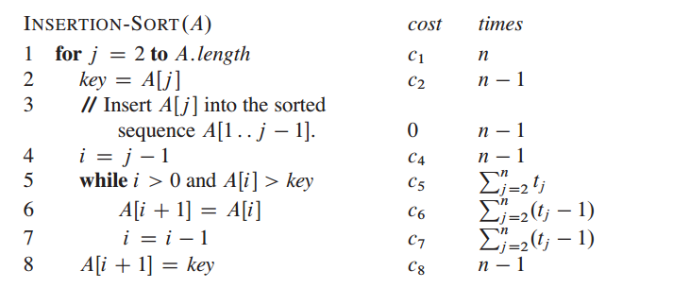
Algorithm Complexity
Iterative

Slide 13
Algorithm Complexity
Recursive → recurrence form
Substitution
Recursion Tree
Master Method

Slide 14
Recursive: Substitution

Slide 15
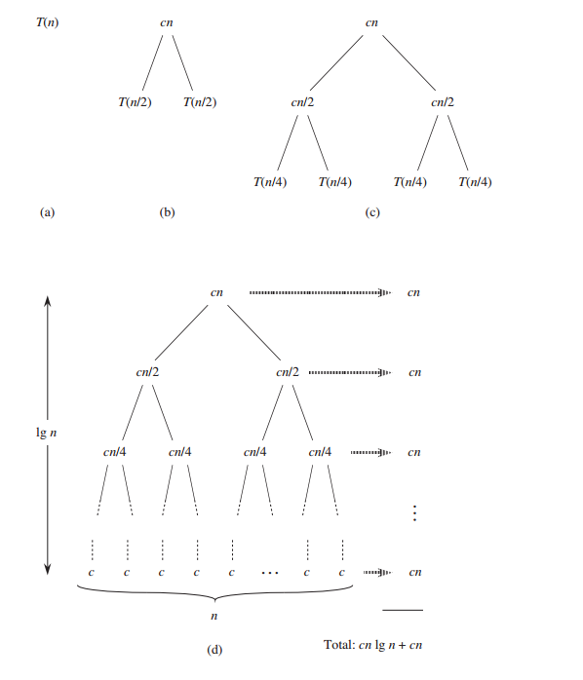
Recursive: Recursion Tree

Slide 16
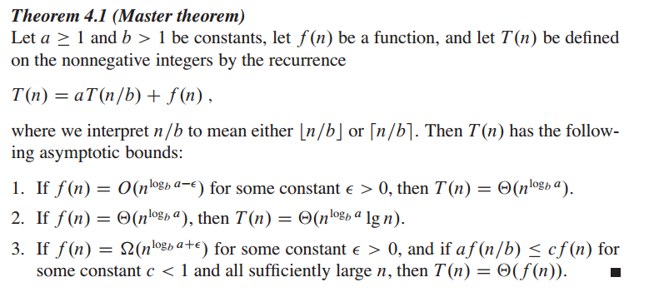
Master Method

Slide 17
Recursive: Master Method

Slide 18
Asymptotic Notation

Slide 19
Asymptotic Notation

Slide 20
Problem Solving Approach

Slide 21
Problem Solving Approach
Observation
Looking for a pattern
Abstraction
Define a pattern → recurrence, iteration
Simplification
Pseudocode
Source code

Slide 22
Example: Fibonacci
We can solve Fibonacci problem using:
Iterative
Recursive
Dynamic Programming → ‘memo table’

Slide 23
Fibonacci: Iterative

Slide 24
Fibonacci: Recursive

Slide 25
Dynamic Programming
Characterize the structure of an optimal solution.
Recursively define the value of an optimal solution.
Compute the value of an optimal solution, typically in a bottom-up fashion → saved in ‘memo’
Construct an optimal solution from computed information

Slide 26
Dynamic Programming (DP)
From RECURSIVE
DP
TOP-DOWN
From ITERATIVE
DP
BOTTOM-UP
http://algorithms.tutorialhorizon.com/introduction-to-dynamic-programming-fibonacci-series/

Slide 27
Fibonacci-DP (top-down)

Slide 28
Fibonacci-DP (bottom-up)
Fibonacci(x)
Arr [x+1]
Arr [0] = 0
for i = 1 to x
if i ≤ 2
Arr[i] = 1
else
Arr[i] = Arr[i-1] + Arr[i-2]
return Arr[x]
memoization
saving sub-problems solution into a “memo”
look up
look up the “memo” for sub-problem solutions if it is exist
“memoization”
“look up”
“memoization”
Arr: | 0 | 1 | 1 | 2 | 3 | 5 | 8 | … | … | …
i | 0 | 1 | 2 | 3 | 4 | 5 | 6 | … | x | x+1

Slide 29
Example: 2-power-of-n
Define an algorithm (pseudocode) to calculate 2^{n} using these approaches:
iterative
Recursive →
Note: Do not use standard library pow(x, n)

Slide 30
Example: 2-power-of-n (iterative)

Slide 31
Example: 2-power-of-n (recursive)

Slide 32
Changing from recursive to DP

Slide 33
Terminology
iterative algorithm
recurrence
substitution method
recursion tree
master method
asymptotic notation
dynamic programming
memo table
top-down DP
bottom-up DP

Slide 34
Summary
Pseudocode convention
Complexity analysis: iterative, recursive
Asymptotic notation
Examples:
Fibonacci: iterative, recursive, DP

